Slide 1
SINA WEIBO INTERACTION PREDICTION
Kle technological university
Data Mining and Analysis
Course Code: 18ECSC301
Team: 5A09
Apoorva S Malemath - 01FE16BCS041
Arundati Dixit - 01FE16BCS046
Ashish Kar - 01FE16BCS047
Deepti Nadkarni - 01FE16BCS062
School Of Computer Science And Engineering

Slide 2


PROBLEM STATEMENT
Predict the forwarding, commenting and liking amount of a Weibo posted by a user based on the historical interaction data on Sina Weibo social platform.
KLETech/CSE/2016-20 Batch/ 5th sem /DMA course project/5ADMACP14 1/

Slide 3
INTRODUCTION
Weibo is a Chinese microblogging website, similar to the Twitter.
“Weibo” is a Chinese word for “microblog”
User behaviors such as forwarding, commenting and liking are important factors that can be used to estimate:
The quality of a certain weibo
Implement the recommendation
Feed controlling strategy
KLETech/CSE/2016-20 Batch/ 5th sem /DMA course project/5ADMACP14 1/

Slide 4
UNDERSTANDING DATA
Training data (weibo_train_data.txt)
No. Of attributes: 7 (categorical: 3, numerical: 4)
Dimensions: 1229618 rows x 7 columns
Predicting data (weibo_predict_data.txt)
No. Of attributes: 4 (categorical: 3, numerical: 1) dimensions: 178297 rows x 4 columns
KLETech/CSE/2016-20 Batch/ 5th sem /DMA course project/5ADMACP14 1/

Slide 5
UNDERSTANDING DATA
Training Data
Attribute | Description
uid | user id. Sampled and encrypted
mid | weibo id. Sampled and encrypted
time | post time. Format YYYYMMDD
forward_count | amount of forward within one week after posting
comment_count | amount of comment within one week after posting
like_count | amount of comment within one week after posting
content | weibo content
KLETech/CSE/2016-20 Batch/ 5th sem /DMA course project/5ADMACP14 1/

Slide 6
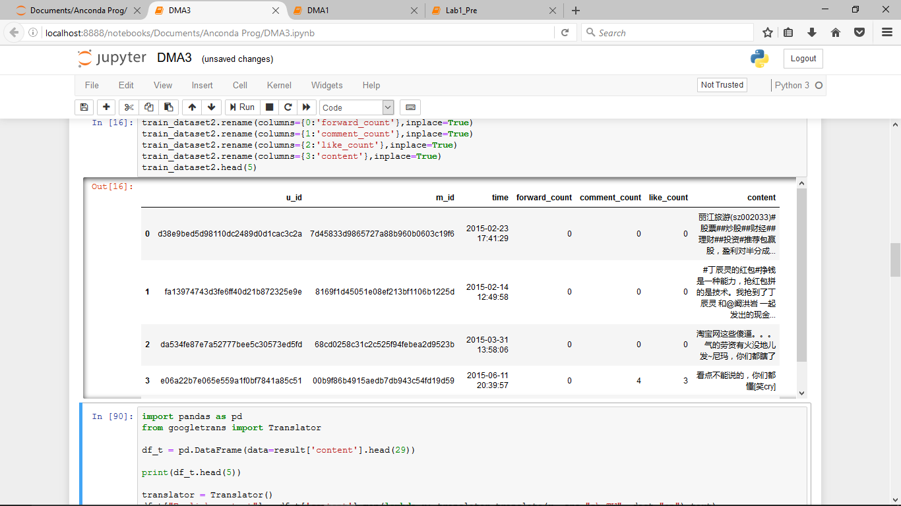
UNDERSTANDING DATA
Training data (weibo_train_data.txt)
KLETech/CSE/2016-20 Batch/ 5th sem /DMA course project/5ADMACP14 1/

Slide 7
UNDERSTANDING DATA
Predicting Result
Attribute | Description
uid | user id. Sampled and encrypted
mid | weibo id. Sampled and encrypted
time | post time. Format YYYYMMDD
Content | weibo content
KLETech/CSE/2016-20 Batch/ 5th sem /DMA course project/5ADMACP14 1/

Slide 8
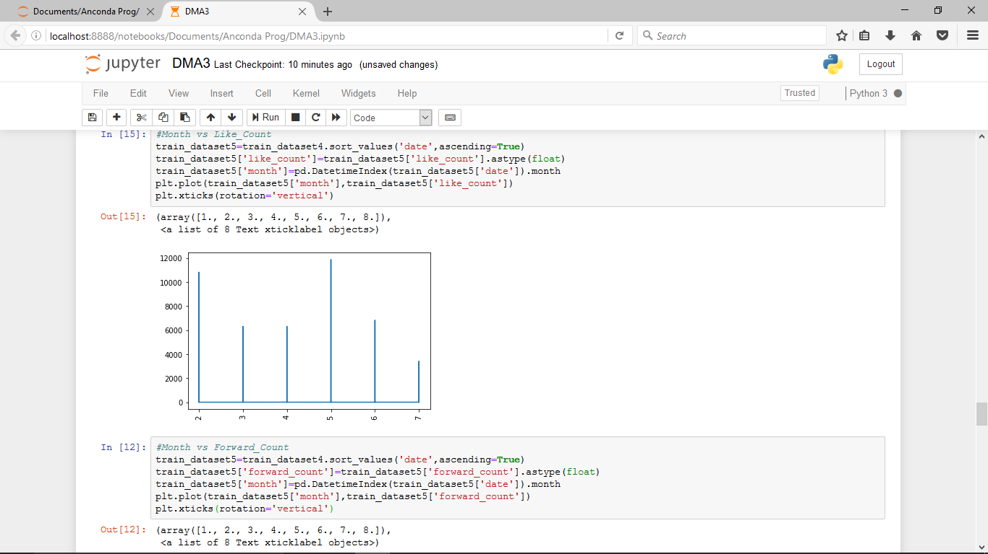
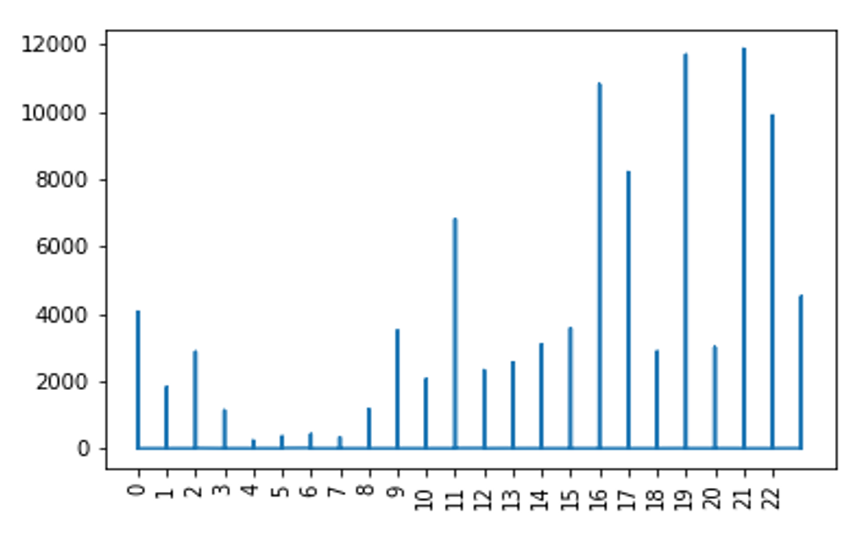
INITIAL OBSERVATIONS
UNDERSTANDING DATA
Our data is of year 2015 ranging from February to July.
More activity is in the month of may and during night time
LIKE
LIKE
LIKE
MONTH
HOUR
KLETech/CSE/2016-20 Batch/ 5th sem /DMA course project/5ADMACP14 1/

Slide 9
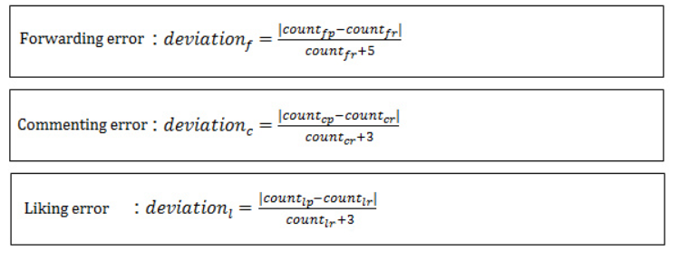
UNDERSTANDING DATA
SCORE
KLETech/CSE/2016-20 Batch/ 5th sem /DMA course project/5ADMACP14 1/

Slide 10
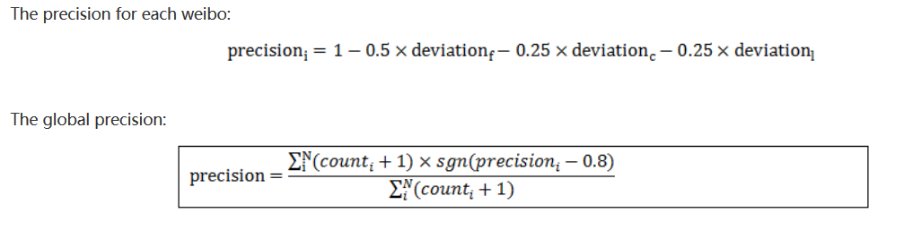
KLETech/CSE/2016-20 Batch/ 5th sem /DMA course project/5ADMACP14 1/

Slide 11
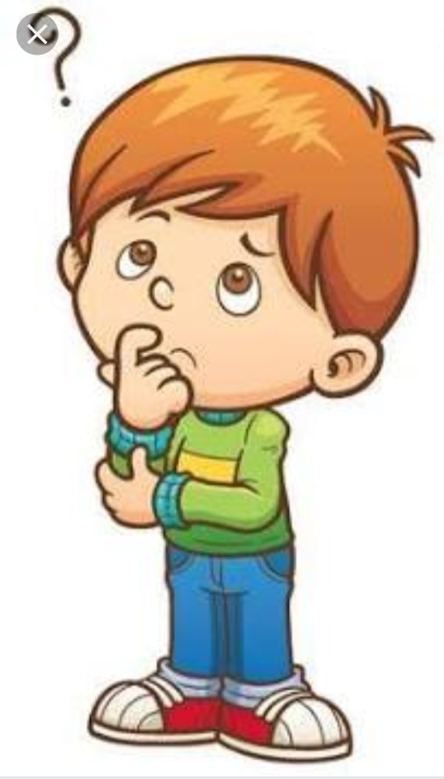
THE APPROACH
STATISTICAL FACTORS
BAG OF WORDS(BOW)
POLARITY

Slide 12
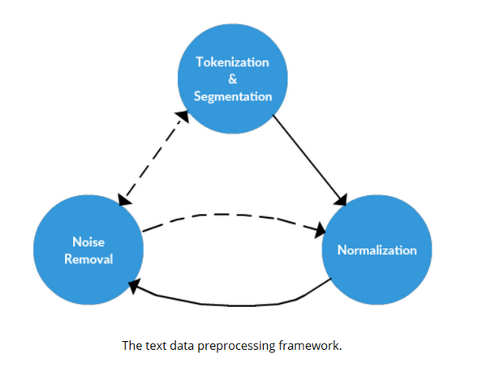
DATA PRE-PROCESSING
Text Preprocessing
Removal of URL
Removal of stop words
Stemming
Lemmatization
Conversion to lowercase
Removal of numbers
Removal of punctuation
KLETech/CSE/2016-20 Batch/ 5th sem /DMA course project/5ADMACP14 1/

Slide 13
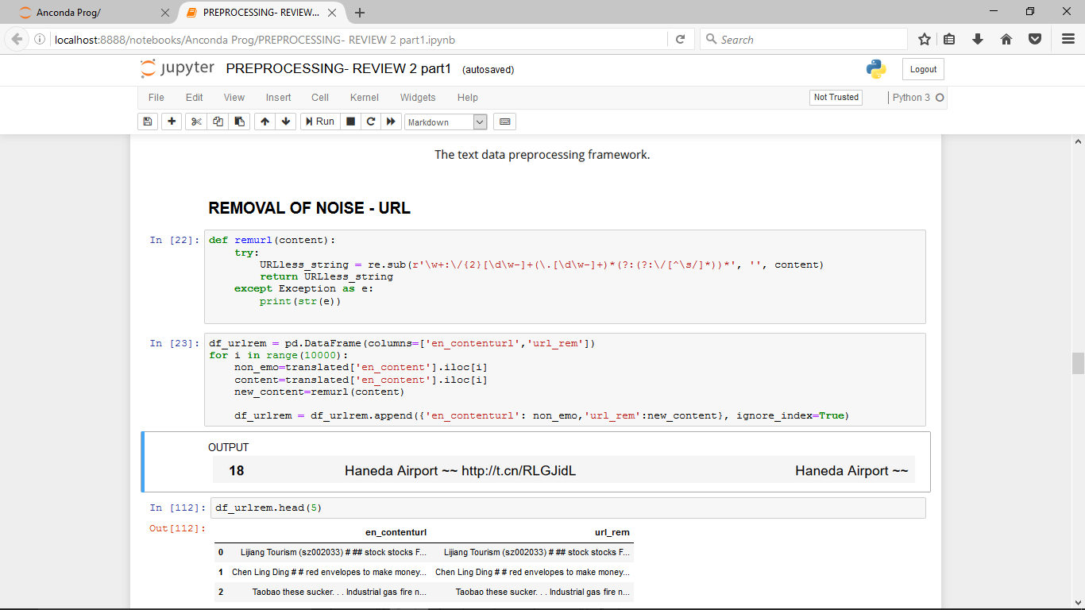
DATA PRE-PROCESSING
Removal of URL
Stemming
SSES -> SS caresses -> caress
IES -> I ponies -> poni
ties -> ti
SS -> SS caress ->caress
S -> cats ->cat
Y -> I happy -> happi
sky -> sky
KLETech/CSE/2016-20 Batch/ 5th sem /DMA course project/5ADMACP14 1/

Slide 14
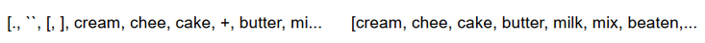
DATA PRE-PROCESSING
Lemmatization
text word to lemma
help help(v)
helps help(v)
helping help(v)
helped help(v)
Removal of Punctuation
KLETech/CSE/2016-20 Batch/ 5th sem /DMA course project/5ADMACP14 1/

Slide 15
DATA PRE-PROCESSING
STATISTICAL FACTORS
We compute the following statistical measures of forward, comment and like count for each uid :
Mean
Median
Max
Min
New factor: forward_mean, forward_median, forward_max, forward_min
comment_mean, comment_median, comment_max, comment_min
like_mean, like_median, like_max, like_min
KLETech/CSE/2016-20 Batch/ 5th sem /DMA course project/5ADMACP14 1/

Slide 16
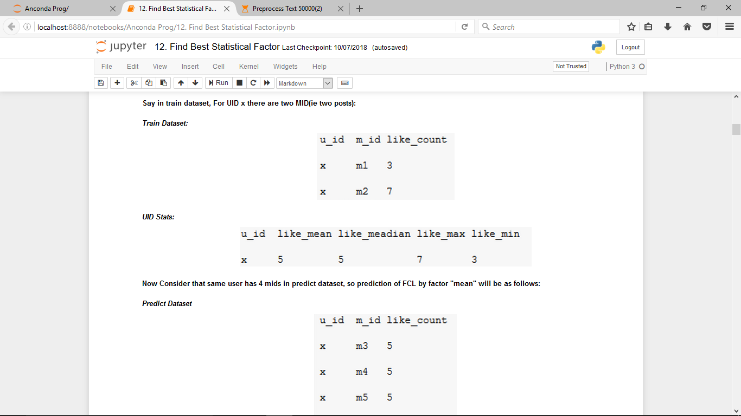
DATA PRE-PROCESSING
KLETech/CSE/2016-20 Batch/ 5th sem /DMA course project/5ADMACP14 1/

Slide 17
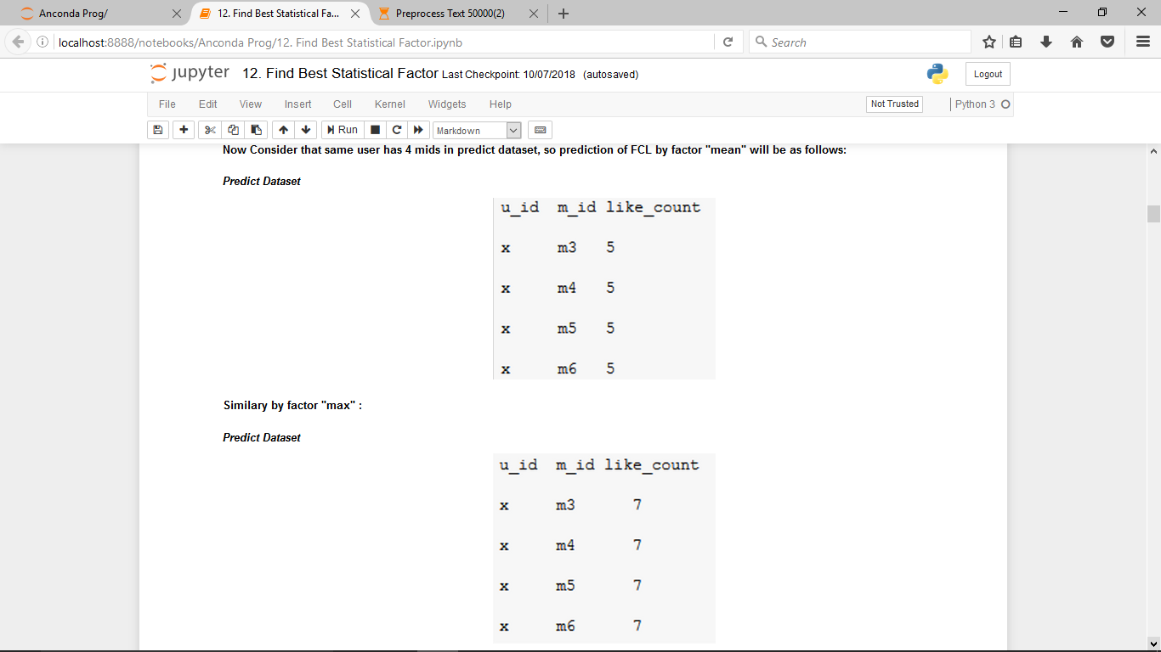
DATA PRE-PROCESSING
KLETech/CSE/2016-20 Batch/ 5th sem /DMA course project/5ADMACP14 1/

Slide 18
DATA PRE-PROCESSING
POLARITY
Compute polarity of content indicating whether content is
Positive or negative. AN INTEGER x:
if x<0 NEGATIVE CONTENT
x=0 NEUTRAL CONTENT
x>0 POSITIVE CONTENT
New factor: polarity
KLETech/CSE/2016-20 Batch/ 5th sem /DMA course project/5ADMACP14 1/

Slide 19
ADDING MORE NEW FACTORS
DATA PRE-PROCESSING
1. Content Factors
a) content_media_count
b) content_#_count
c) content_@_count
d) content_?_count
e) content_!_count
f) content_length
g) content_emoji_count
2. Time Factors
a) hour
b) min
c) sec
TOTAL FACTORS NOW: 26
KLETech/CSE/2016-20 Batch/ 5th sem /DMA course project/5ADMACP14 1/

Slide 20
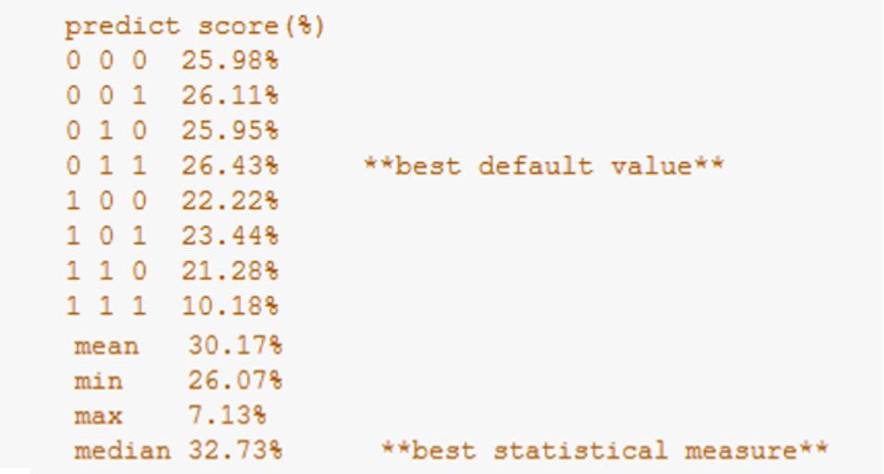
MODEL BUILDING
KLETech/CSE/2016-20 Batch/ 5th sem /DMA course project/5ADMACP14 1/

Slide 21
MODELLING WITH MORE FACTORS
MODEL BUILDING
Attributes | Score
Media, #, @, ?, !, Length, Emoji | 13.69%
Media, Length, Emoji | 13.79%
Time: (Hour, Min, Sec), Media, Length, Emoji | 15.41%
Median, Time: (Hour, Min, Sec), Media, Length, Emoji | 32.47%
Median, Min, Max, Media, Emoji (SEPARATE MODELS) | 38.03%
Median, Min, Max, Media, Emoji, Default Values (SEPARATE MODELS) | 38.03%
KLETech/CSE/2016-20 Batch/ 5th sem /DMA course project/5ADMACP14 1/

Slide 22
MODEL BUILDING
*BOW is only for first 10,000 Tuples
Attributes | Score
Media, Length, Emoji, Median, Polarity | 35.39%
Media, Length, Median, Polarity | 34.58%
Media, Length, Emoji, Median, Mean, Polarity | 34.22%
BOW (As an array) | 9.21%
BOW using Counter Vectorizer | 15.43%
BOW, media count, forward median, comment median, like median, emoji content | 15.89%
KLETech/CSE/2016-20 Batch/ 5th sem /DMA course project/5ADMACP14 1/

Slide 23
MORE PACKAGES FOR MODELLING
RIDGE
LASSO
ORDINARY LEAST SQUARES
RANDOM FOREST
LINEAR REGRESSION
KLETech/CSE/2016-20 Batch/ 5th sem /DMA course project/5ADMACP14 1/

Slide 24
MODEL BUILDING
MODEL USED | SCORE
Linear Regression | 34.22%
OLS | 35.39%
Ridge regression | 35.48%
Lasso regression | 35.58%
Random Forest | 30.01%
KLETech/CSE/2016-20 Batch/ 5th sem /DMA course project/5ADMACP14 1/

Slide 25
Normalizing Polarity
MODEL BUILDING
The models use content media count, normalized polarity and mean, median, mode, min, max of each of the number of forward, comment and like.
Models | Score
Random Forest Regressor | 78.92%
Linear Regression | 77.17%
KLETech/CSE/2016-20 Batch/ 5th sem /DMA course project/5ADMACP14 1/

Slide 26
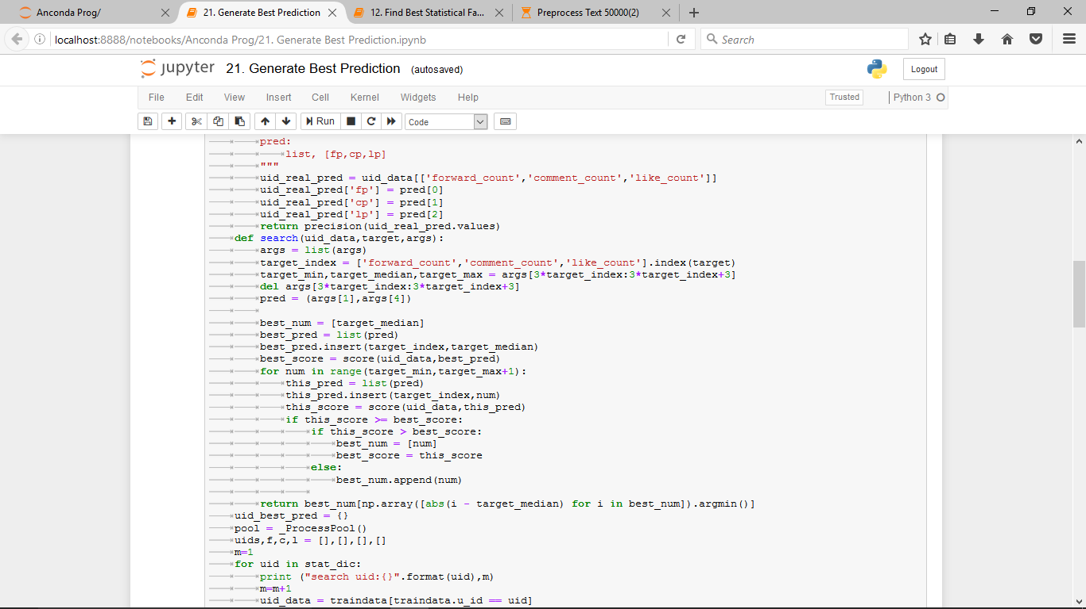
UID FCL best match model
MODEL BUILDING
A heavy computation model using multiprocessing
Let’s see key algorithms used in this model….
KLETech/CSE/2016-20 Batch/ 5th sem /DMA course project/5ADMACP14 1/

Slide 27
MODEL BUILDING
Say in train dataset for an u_id x:
U_id m_id forward_count_x
X m1 5
X m2 7
X m3 3
Forward_min
Forward_median
Forward_max
3
5
7
Prediction of forward_count_y for u_id x in range (3,7) which produces the best score for that u_id
Initially, median is assumed to have best score and is being compared with other numbers in range
Similarly calculations for best like_count and comment_count are computed for each u_id and stored for prediction in predict dataset and generate result
KLETech/CSE/2016-20 Batch/ 5th sem /DMA course project/5ADMACP14 1/

Slide 28
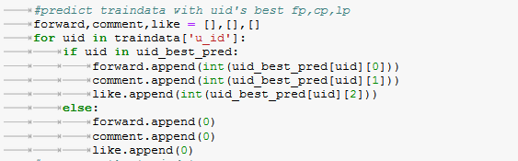
MODEL BUILDING
In predict dataset once any u_id is encountered for prediction the best values we stored earlier are appended as result
For new u_id in predict_dataset 0 0 0 are appended as f c l in the result
KLETech/CSE/2016-20 Batch/ 5th sem /DMA course project/5ADMACP14 1/

Slide 29
MODEL BUILDING
In predict dataset once any u_id is encountered for prediction the best values we stored earlier are appended as result
For new u_id in predict_dataset 0 0 0 are appended as f c l in the result
KLETech/CSE/2016-20 Batch/ 5th sem /DMA course project/5ADMACP14 1/

Slide 30
PERFORMANCE EVALUATION
Attributes and Models | Score
Median, Min, Max, Media, Emoji - Linear Regression (SEPARATE MODELS) | 38.03%
Media, Length, Emoji, Median, Polarity - Linear Regression | 35.39%
Median, Min, Max, Media, Emoji - Lasso regression | 35.58%
UID specific search using median – Linear Regression | 32.73%
UID specific search using best match – Algorithmic approach | 34.76%
Median, Min, Max, Media, Content media, normalized polarity – Random Forest Regressor | 78.92%
KLETech/CSE/2016-20 Batch/ 5th sem /DMA course project/5ADMACP14 1/

Slide 31
LEADER BOARD RANKING
Model | Score | Rank
UID specific search using median | 29.38% | 241
UID specific search using best match | 29.68% | 218
KLETech/CSE/2016-20 Batch/ 5th sem /DMA course project/5ADMACP14 1/

Slide 32
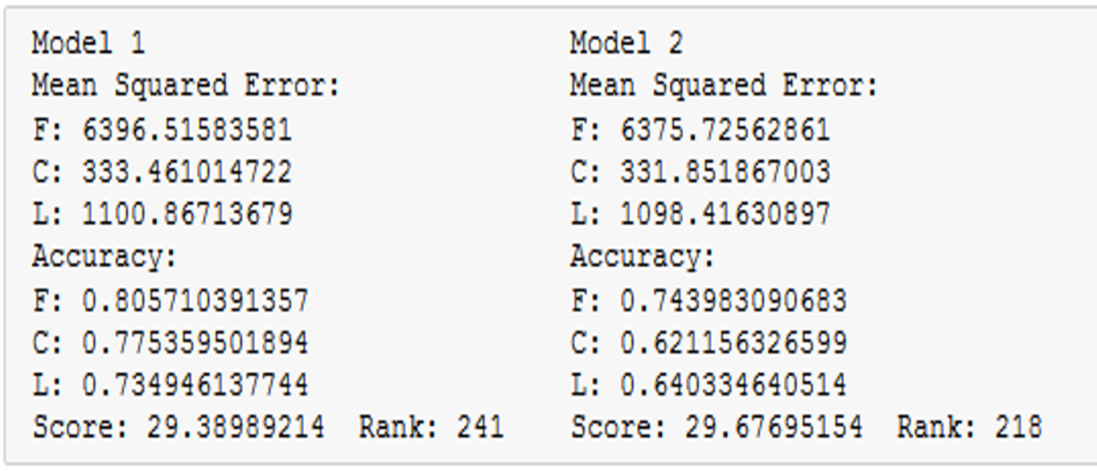
MODEL ANALYSIS
UID FCL MEDIAN MODEL
UID BEST FCL MATCH MODEL
KLETech/CSE/2016-20 Batch/ 5th sem /DMA course project/5ADMACP14 1/

Slide 33
CONCLUSIONS
We built models to predict the number of forwards, comments and likes for a weibo.
Iterative KDD process to refine the pre-processing of data and improve the performance of model.
Algorithmic approach where we defined the best possible value for each user based the UID yielded good result.
Computing polarity of the text and performing a min max normalization on it yielded a score of 78.92% on the cross validation.
KLETech/CSE/2016-20 Batch/ 5th sem /DMA course project/5ADMACP14 1/

Slide 34
THANK YOU

